Slide 1

The Effect of Demographics on Violent Crime Rates in the US
The Effect of Demographics on Violent Crime Rates in the US
The Effect of Demographics on Violent crime Rates n the US
Temidayo Akinsanya
Cheryl Johnson
Johns Hopkins University Data Analytics Bootcamp
Project 1
Temidayo Akinsanya
Cheryl Johnson

Slide 2
Project Description
The Effect of Demographics on Violent Crime Rates in the US
Project-One
Members: Temidayo Akinsanya and Cheryl Johnson
This project will seek to examine cities in all states in the United States and extract and compare the cities in each state that have the highest and lowest crime rate per capita.
The comparison will examine several data points:
> Average Income > Race
> Unemployment Rate > Poverty Rate
> Education Level > School Enrollment Status
> Marital Status > Population
The Effect of Demographics on Violent crime Rates n the US
Temidayo Akinsanya
Cheryl Johnson

Slide 3
Research Questions
Is there a correlation between the level of violent crime and the presence of lack thereof of living arrangements with higher proportion of married spouses?
Can the rate of school enrollment predict the level of violent crime rate in America cities?
Is violent crime rate more likely to be higher in cities with a particular race?
Is there a correlation between poverty rate and violent crime rate?
Is there a correlation between unemployment and violent crime rate?
The Effect of Demographics on Violent crime Rates n the US
Temidayo Akinsanya
Cheryl Johnson

Slide 4
Data Sources
Datasets Used: Census 2015 ACS Data FBI 2015 Violent Crime Data
https://ucr.fbi.gov/crime-in-the-u.s/2015/crime-in-the-u.s.-2015/tables/table-8/table_8_offenses_known_to_law_enforcement_by_state_by_city_2015.xls/view
https://www.census.gov/programs-surveys/acs/technical-documentation/table-and-geography-changes/2015/5-year.html
Describe selection of data sources
Describe data within data sources to be used
Describe challenges with
Matching the data between the two data sources
Challenges with FBI data and getting it into csv
The Effect of Demographics on Violent crime Rates n the US
Temidayo Akinsanya
Cheryl Johnson
Notes:
[see Memo 2 Page 4 -5 for discussion]

Slide 5
Data Exploration & Cleanup
Describe process to clean up data
The Effect of Demographics on Violent crime Rates n the US
Temidayo Akinsanya
Cheryl Johnson

Slide 6
Data Analysis
Data analysis steps
The Effect of Demographics on Violent crime Rates n the US
Temidayo Akinsanya
Cheryl Johnson

Slide 7
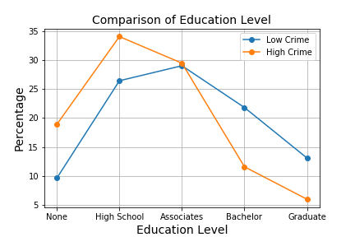
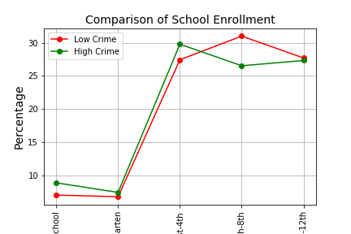
Observations: Education Level, School Enrollment
Education Level
The Effect of Demographics on Violent crime Rates n the US
Temidayo Akinsanya
Cheryl Johnson
School Enrollment

Slide 8
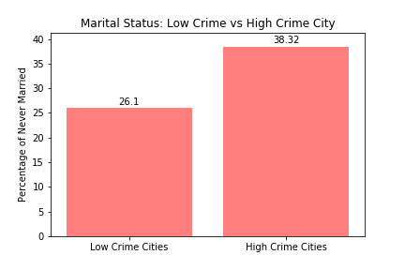
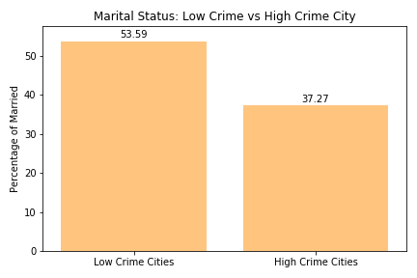
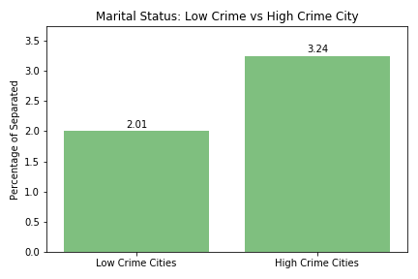
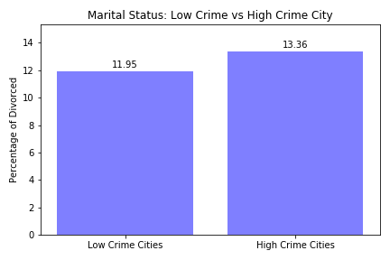
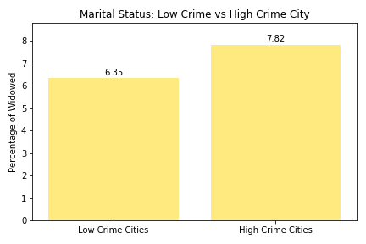
Observations: Marital Status
For low crime cities, the largest Marital Status category is “Married” at nearly 54% (compare to high crime cities, where 37% are classified as “Married”)
For high crime cities, the largest Marital Status category is “Never Married” at 38% (compare to low crime locations, where 26% are classified as “Never Married”)
Between low crime and high crime cities, the Marital Status categories with little difference are “Separated” (2% vs 3%), “Divorced” (12% vs 13%), and “Widowed” (6% vs. 8%)
The Effect of Demographics on Violent crime Rates n the US
Temidayo Akinsanya
Cheryl Johnson

Slide 9
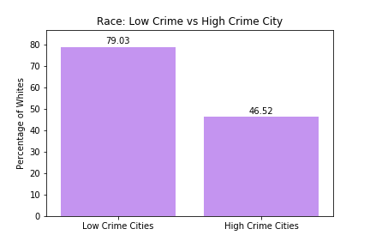
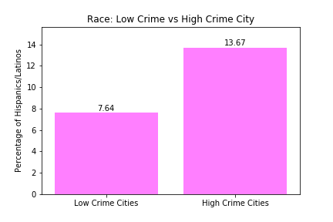
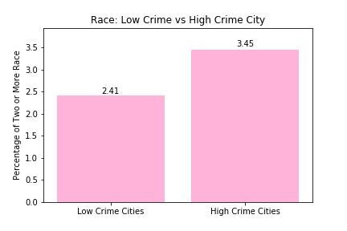
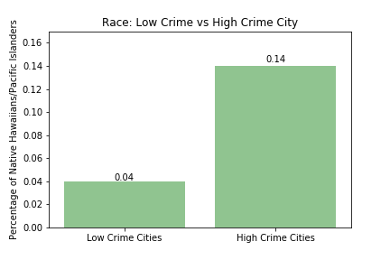
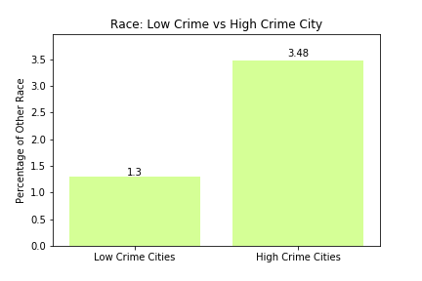
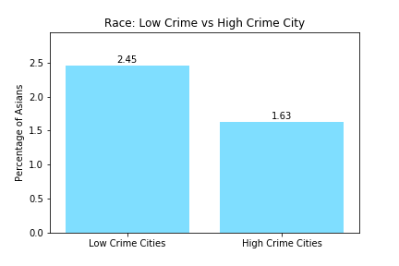
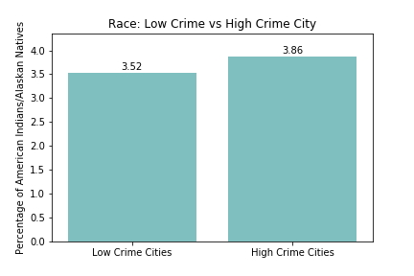
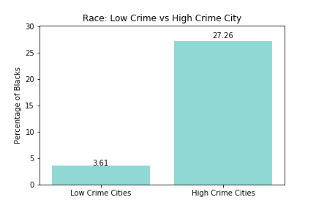
Observations: Race
The Effect of Demographics on Violent crime Rates n the US
Temidayo Akinsanya
Cheryl Johnson

Slide 10
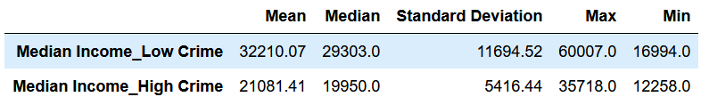
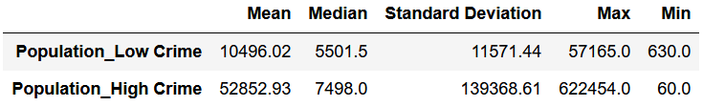
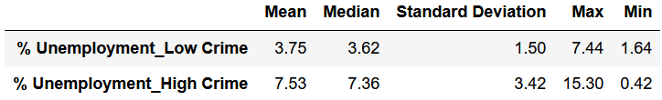
Observations: Education Level, School Enrollment
The Effect of Demographics on Violent crime Rates n the US
Temidayo Akinsanya
Cheryl Johnson

Slide 11
Conclusions
Based on our Analysis, our findings are:
A
B
The Effect of Demographics on Violent crime Rates n the US
Temidayo Akinsanya
Cheryl Johnson

